Slide 1
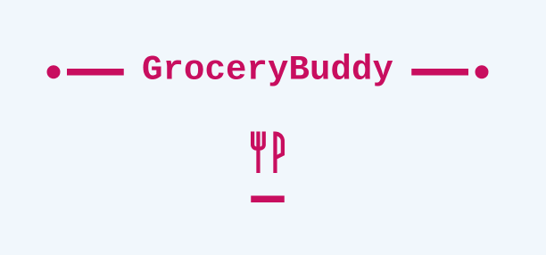
By: Group 1

Slide 2
Presentation Order
Introductions
Introducing Group 1:
Overview/Proposal
Sumaiya Tabassum
Daniel Jacobs
Romaine Ewan
Raissa Padua
Eli Kleinworm
Dan Huynh
Project objective
Front End
Back End
QA/Requirement Specifier & Tech Writer
Future Plans/Closing

Slide 3
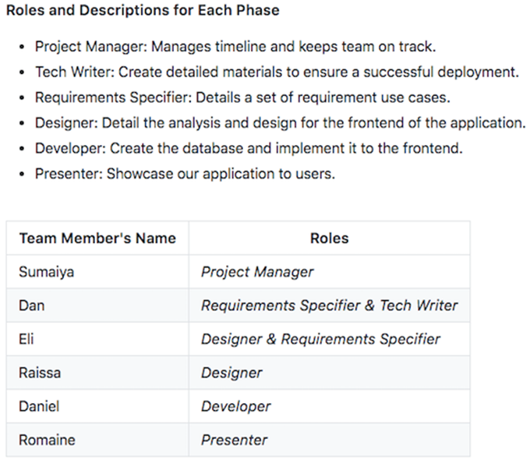
Team Roles

Slide 4
Overview/Proposal
Project: Build a web product that functions on mobile which will guide users to a portal to make an account and sign in to gain more functionality of the product.
Initial Idea: A weekly calendar that will serve as a reminder for users on buying certain grocery items (basically an alarm), THERE WAS NO BUSINESS PLAN TO THE ORIGINAL IDEA.
New Idea: In addition to the original proposal, in which the user will be reminded of what products to purchase on a particular day on a weekly basis, a price comparison between stores will be allowed. The idea is to allow users to search any item they want (but of-course, in there will be some restrictions)
Features such as automatic e-mail notifications will be added.

Slide 5
Front End
Our front end experts Raissa Padua and Eli Kleinworm worked towards creating a seamless interface for all users to easily jump in and get started. With Sumaiya Tabassum help they designed the logo. After signing up through the initial sign up page, the user is then presented with the freedom to navigate and modify the app.

Slide 6
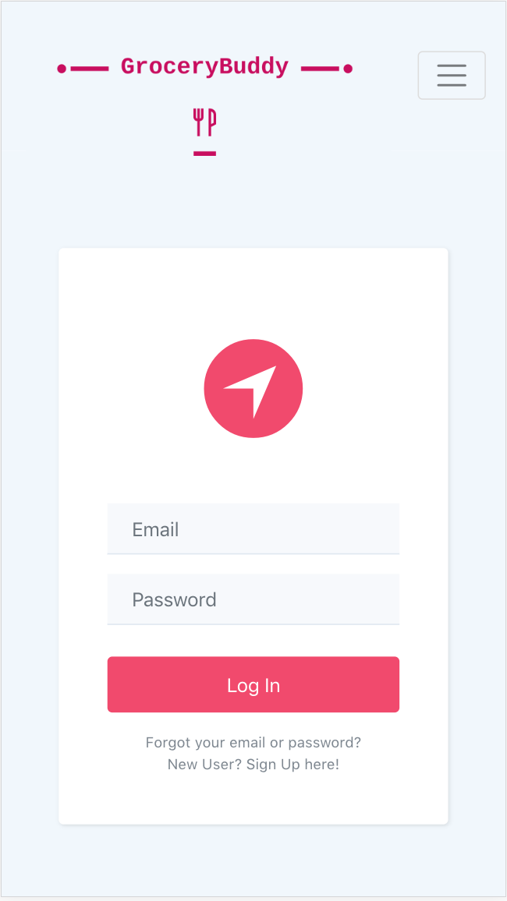
Front End - Log In
As a user you are initially presented with a log in page. Here you are prompted to enter your email and password. Located below the log in button are links to reset your email or password if you forgot either one. You may also Sign up as a user.
To log in enter your full email and password into their respective email and password box. Then click the Log In button. Click the link below the log in button to reset your password should the need present itself. To sign up as a new user, click the second link below the log in button.

Slide 7
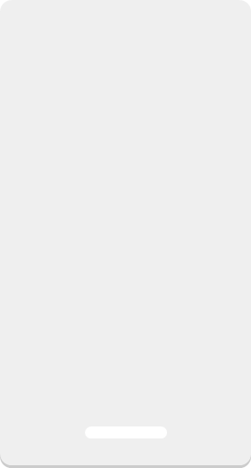
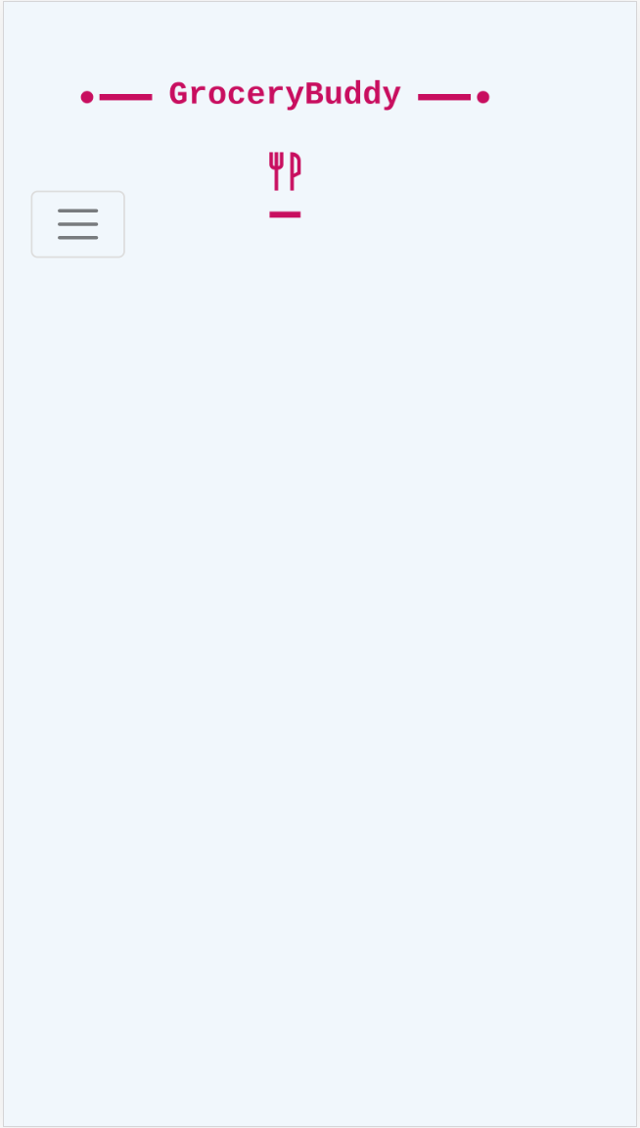
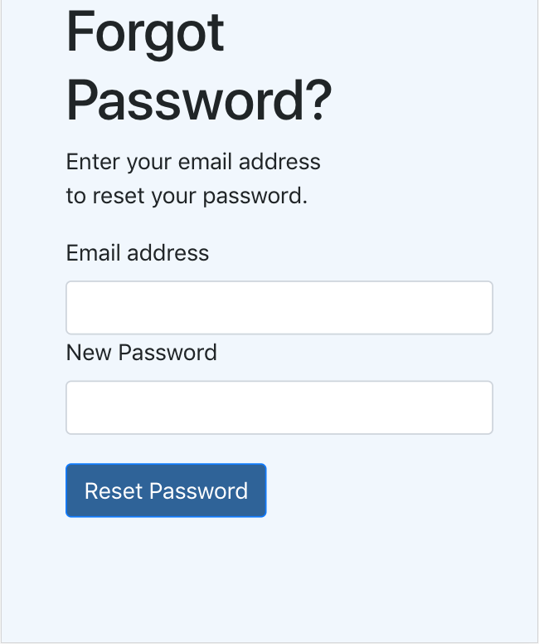
Front End - Forgot Password
On this page you are free to reset your password whenever you want. To accomplish this you’ll need your registered email address and new password.
To begin resetting your password, enter your registered email and password in their respective text boxes. Then click the reset password button below.

Slide 8
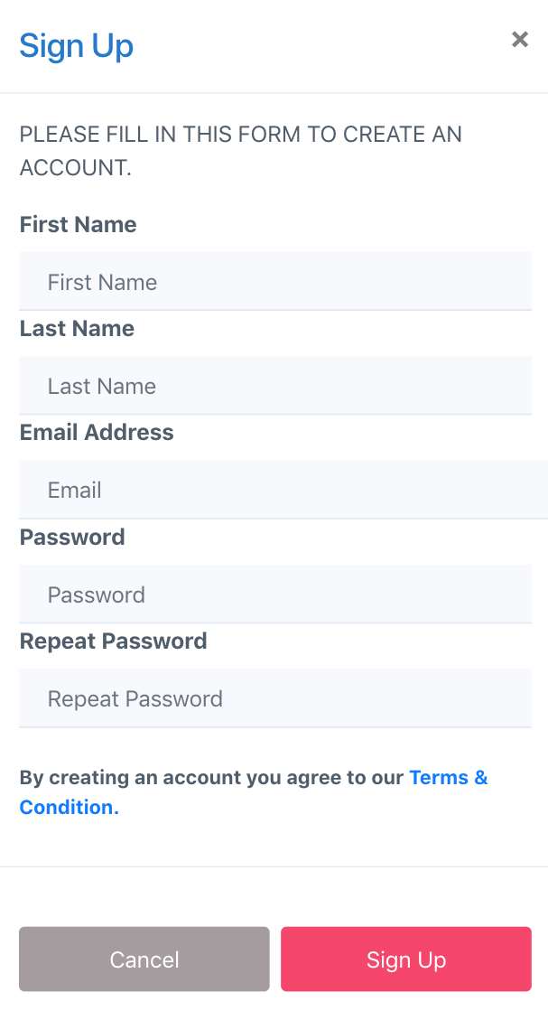
Front End - Sign Up
Here on the sign up page GroceryBuddy allows you to sign up for your personal account on the app. This will allow all your changes and modifications be yours and YOURS ONLY once you begin your GroceryBuddy journey.
As you can see in the image to the left, to sign up you will need to fill out the form with the information it prompts you to enter into each text box. The information you will need is your first name, last name, email address and password.

Slide 9

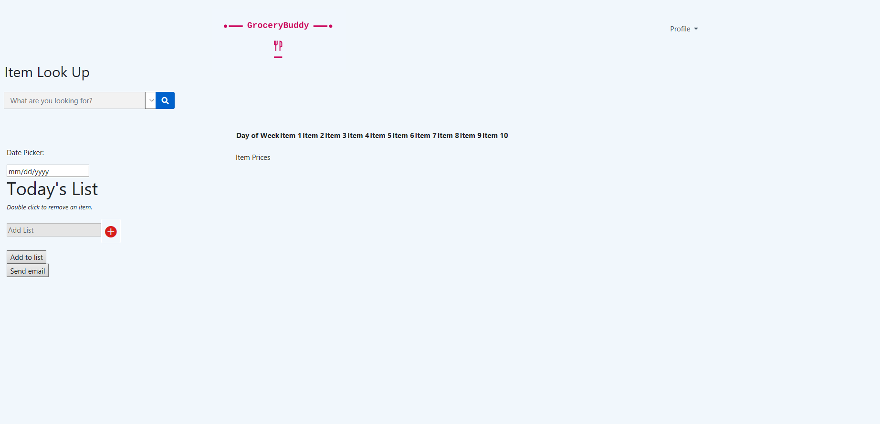
Front End – Home Screen
This home screen is your base of operations for your GroceryBuddy experience. Displayed across the middle to bottom portion of the screen, are the 7 days of the week in calendar format. Each day displays a list with a max of 10 items you are free to add or remove. Items are found by searching them in the item look up bar located to the top left of the screen. You can log out at any time at the top right through the Profile menu.

Slide 10
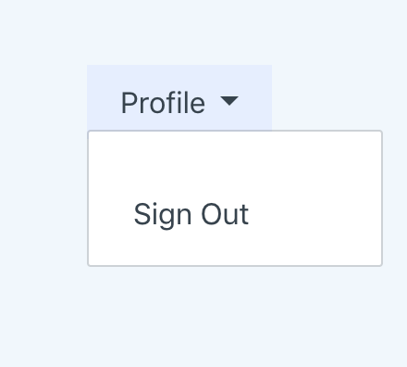
Front End - Sign Out
Once logged in the GroceryBuddy app you can easily log out at anytime. Click the Profile button at the top right of the home screen to see the sign out option. Click sign out to log out of your account to the log in screen.

Slide 11
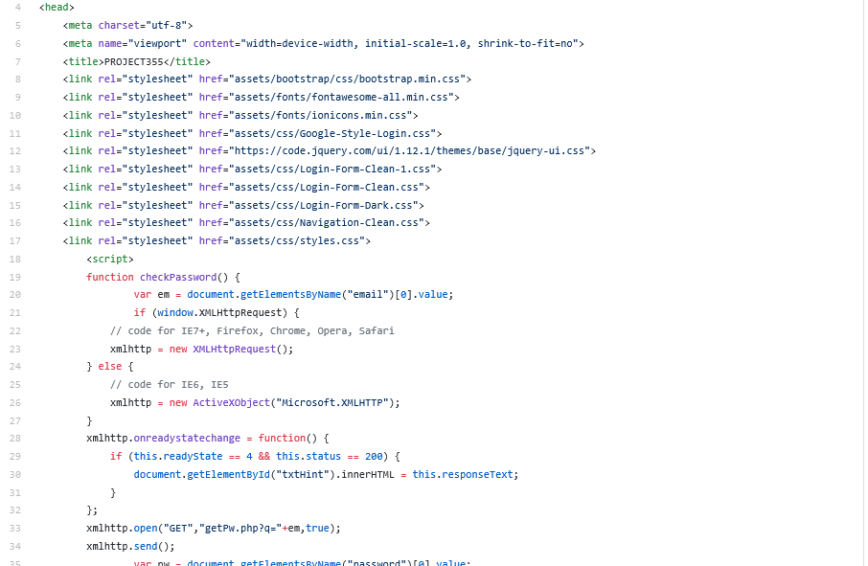
Front End - Code
We used bootstrap to develop the front end of the app. This allowed us to get a smooth front end done quickly without too much trouble. The most challenging part was designing the days with their lists.

Slide 12
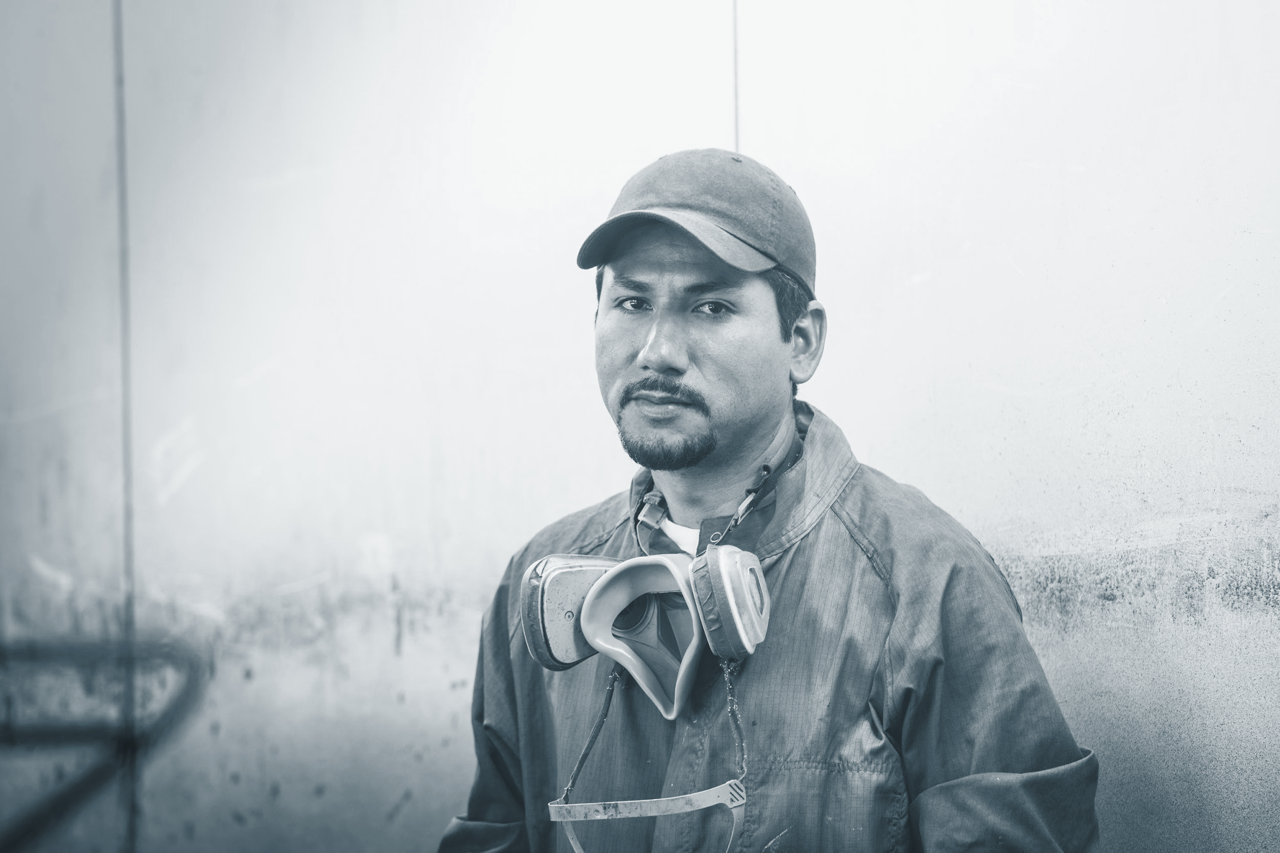


Back End
Our back end experts Daniel Jacobs along with Sumaiya Tabassum and Dan Huynh worked towards creating the a functionality of the database, internet hosting and email aspects of the app. They made it possible for the users to use the app on mobile or desktop. This is while letting you actually see the lowest prices available for certain items they look up in GroceryBuddy and the store they are from.

Slide 13
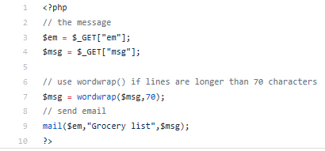
Back End - Code
We used primarily php and mysql to develop the back end of our app. For this stage of development, matching functionality to the designs of the front end was the biggest challenge.

Slide 14
QA/Requirement Specifier & Tech Writer
Our Requirement Specifier & Tech Writer experts Dan Huynh and Eli Kleinworm, worked towards preventing mistakes and defects in our GroceryBuddy app to avoid problems with the finished product. Seeing it from a customers point of view and a developer’s as well, they conducted testing through different methods to make sure things were how they should be. If any errors were found, they informed they group on them with some advice on how it could be fixed.

Slide 15
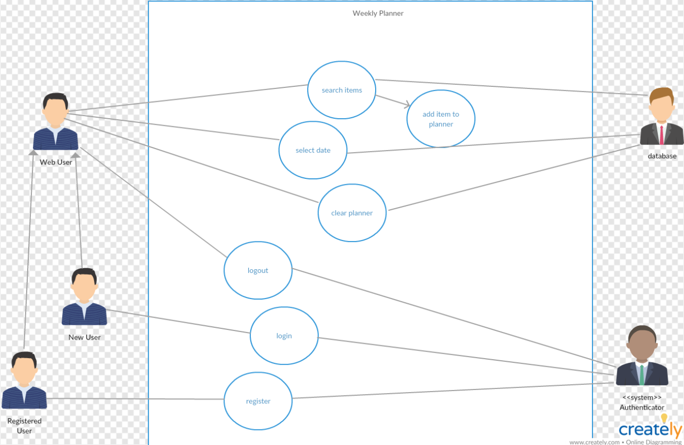
QA-Use Case
This is a set of possible sequences of interactions between systems and users in the app environment.

Slide 16
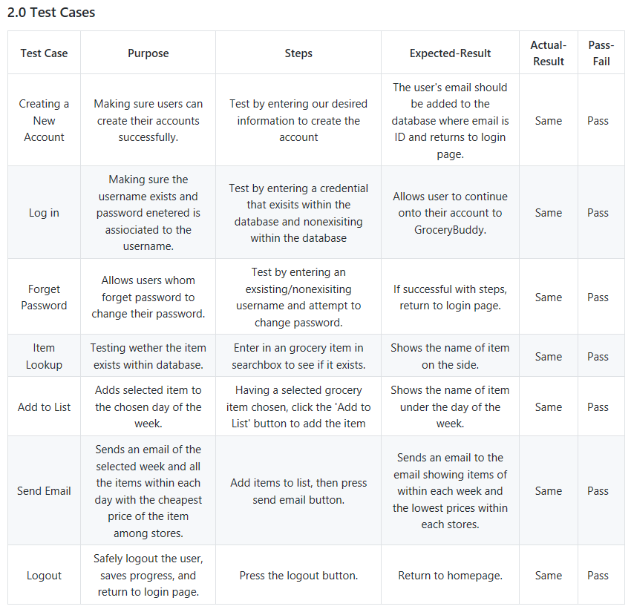
QA – Test Case
Our system testing will be performed by generating a list of potential actions that the end-users can partake in, and going through every one of those scenarios one-by-one.

Slide 17
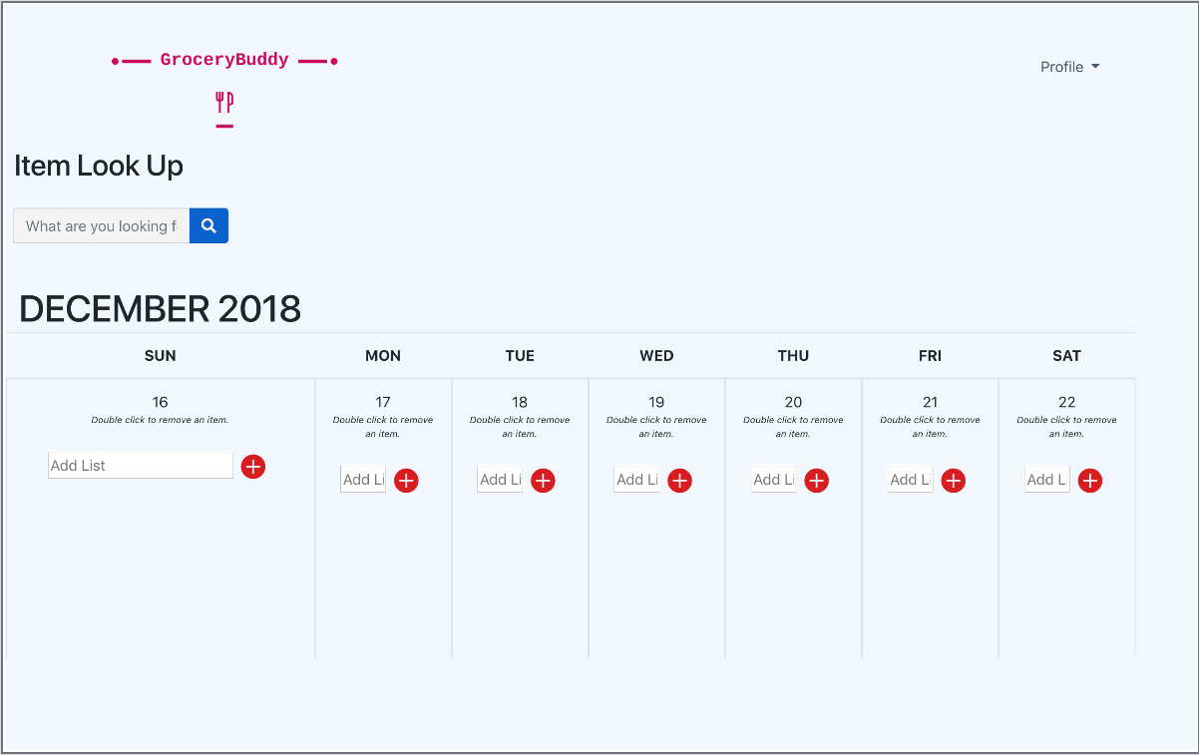
Future Plans
Our first version had limited items and stores. We would add more searchable products and stores to our database. The front end design would also be updated to the image you see here.

Slide 18
Closing - Links
https://github.com/craniumcadoo/CS-355-Final-Presentation - GitHub
https://venus.cs.qc.cuny.edu/~jada1750/Final/index.html - App
Thank You !

